Slide 1
New Faculty Career Planning

Slide 2
Exercise
❖ Write on this page what you expect to find most stressful about becoming a faculty member
❖ Break into groups of 4-6,
introduce yourselves, and share
this information

Slide 3
What Do We Know About
New Faculty Development?
◆ Stress Points (Sorcinelli, 1992)
⧫ Not enough time
⧫ Inadequate feedback and recognition
⧫ Unrealistic self-expectations
⧫ Lack of collegiality
⧫ Balancing work and outside life

Slide 4
Faculty Characteristics (Boice 1991, not limited to engineering faculty, extremes)
Quick Starters
❖ Seek social
support / advice
❖ Exemplary teachers
❖ positive attitude
towards students
❖ less time
preparing for class
❖ more time on
scholarly work
❖ complain less
Unsuccessful
❖ Confused about
expectations
❖ Feel socially isolated
❖ Scholarly work only
verbal priority, low
actual time
❖ Defensive teachers
❖ lecture only
❖ content focus
❖ avoid bad
evaluations

Slide 5
Slide 1 of 2
Success Strategies
◆ Schedule regular time for scholarly
writing (proposals, papers, reports);
keep time log
❖ 30-45 minutes daily or 2-3 longer
blocks weekly
❖ Keep record of time spent on all activities
◆ Limit preparation time for class
(especially after the first offering)
❖ < 2 hours preparation for 1 hour of lecture
❖ Keep track of time spent in time log

Slide 6
Slide 2 of 2
Success Strategies
◆ Network at least 2 hours / week
❖ Visit offices, go to lunch, have a cup of coffee
with colleagues in and out of the department
❖ Discuss research, teaching, campus culture
◆ Develop clear goals and
a plan to reach them
❖ Get feedback on plans from department head, mentor,
other colleagues, and make adjustments
❖ Use planning tool (e.g. Gantt chart to plan course
development, research, presentations, publications)
❖ Periodically review progress (at least annually)

Slide 7
Collegiality & Service
Be friendly
No excuse for surly, rude behavior
Service – Projects
Pick one you enjoy & make it yours
(e.g., contest for high school day)
Service – the Commons
Do your share (but not more) of committees, homecoming, visitors and so forth.

Slide 8
Faculty Time Scales
◆ Next lecture 2 days
◆ Proposal written 4 weeks
◆ Course 4 months
◆ Publication submitted-published 6 months
◆ Annual evaluation 1 year
◆ Mid-career review 3 years
◆ PhD graduates 4 years
◆ Tenure package due 5 years

Slide 9
New Faculty Career Planning

Slide 10
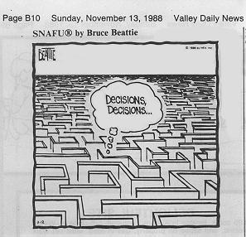
“If you don’t know where you are going, any road will get you there.”
The Cheshire Cat Alice in Wonderland
SNAFU®by Bruce Beattie Valley Daily News Nov. 13, 1988

Slide 11
Components of Career Planning
❖ Research Career
❖ Teaching Career
❖ Professional Career
❖ Personal Career
Career Elements Are Connected

Slide 12
What Does University Want?
Research University
Money
Impact & Fame
Good Teaching
Collegial & Service
Teaching Institution
Great Teaching
Collegial & Service
Money
Impact & Fame
Courtesy Phil Wankat

Slide 13
Missions
What you have a passion for . . .
❖ What are your
strengths?
❖ What do you like
learning?
❖ What outcome would
you like to see?
❖ Who do you admire?
May change with time
Goals
What you would hope to accomplish . . .
❖ You decide vs.
others decide
❖ Routine vs.
non-routine
❖ Idealistic vs.
realistic
❖ Growth goals

Slide 14
Objectives and Activities: The Plan to Achieve Your Goals
What you will accomplish
by specific Activities ?
❖ List only feasible activities
❖ Be specific
❖ Include activities currently doing
❖ State time frame –
can separate (week, term, year)
❖ Prioritize list – cannot do all

Slide 15
Example
Mission: Contribute to realizing broader use
of solar energy
Goal (6 yr): Obtain tenure
Sub goals: Established funded research
program in photovoltaics
Objectives: Submit a CAREER proposal this semester
Activities:
❖ Write literature review by March 15
❖ Have student complete preliminary experiment by April 15
❖ Draft white paper of proposed REU concept by April 1
❖ Call NSF program manager on Monday to discuss questions

Slide 16
Implementation
❖ Establish realistic balance; eliminate
goals if necessary
❖ Implement in context of your situation
(institution, family, health, finances…)
❖ Revisit periodically – goals change
❖ Obtain feedback and tune (chair, colleague,
mentor)
❖ Keep it visible (e.g., white board,
Gannt chart)

Slide 17
Research Career Planning
Note: This workshop will focus on establishing and developing a research career, but encourage you to attend other workshops on teaching (e.g., NETI) and professional development.

Slide 18
From
Graduate Student
to Faculty
What do you expect to be the most difficult aspect about the transition from Graduate Student to Faculty?

Slide 19
Research Career
❖ Develop 5-year and long term plans
and revise (at least annually)
❖ Peer recognized excellence (‘potential’
required for tenure at most institutions)
in research area is long term goal
❖ Important to remain research active
throughout career (traditional graduate
program, REU’s, collaborate with
industry, sabbaticals, education
research . . . )

Slide 20
Research Areas
❖ Most researchers only work in a few
research areas during their career (~1 to 5)
❖ Identify engineering science(s) (base)
and technology (driver)
❖ Criteria for selection: Interesting,
importance of problem, match to your
skills, long-term funding prospects,
available resources, presence of
colleagues, fit with department vision,
student interests, local interests

Slide 21
Research Hierarchies
❖ Chemical
Engineering
Research Discipline
Established
❖ Electronic Materials
Processing
Likely fixed
(sometimes
different than
Ph.D. topic)
Research Field
❖ CVD of
semiconductors
❖ Bulk crystal growth
❖ Solid-state sensors
Research Area
Only a few in
one’s career
❖ p-type doping
of GaN
Research Issues
Distinguishes
Problem Solution
Innovative
❖ Cluster doping

Slide 22
The Numbers ($)
Slide 1 of 3
◆ Graduate students: 5 yr. before first PhD
& continuity, 1 PhD/yr = group size 6-7,
40 yr career = 35 PhDs in career
◆ 35 solutions; ~20 problems; few
research areas in career
◆ Grad. student cost: $22K (stipend)+11K
(overhead)+7K (tuition) = $40K/yr
◆ $280K (7 students) + 50K (3 summer mo)
= $320K + cost of research
(~30K/student) = $530,000/yr funding

Slide 23
The Numbers (time)
Slide 3 of 3
◆ Idea to publication: 3 to 7 years
◆ t = 0 (idea) + 3 mo (preliminary results)
+ 2 mo (write proposal)
+ 3-6 mo (review)
+ 1-13 mo (funding cycle - note 10/1)
+ 0-12 mo (identify graduate student)
+ 12-36 mo (do research)
+ 3 mo (write manuscript)
+ 6-15 mo (submit / review / publish)
= 30-90 months

Slide 24
Already Have Grant or Do Without $
Theory/Modeling
t=0 idea
+ 1-3 months, theory/simulations
+ 1-3 months, write
+ 6-15 months, submit, review & publish
= 8-21 months
Experimental
t=0 idea
+3-12 months, experiments
+1-3 months, write
+ 6-15 months, submit, review & publish
= 10-30 months

Slide 25
Identifying Research Area
and Issues in your Field
❖ Extension of thesis
or post-doctoral research
❖ Easiest but competing with former advisor(s)
❖ Tangent to thesis
or post-doctoral research
❖ Easy transition but credibility not fully
established
❖ New area
❖ Longer time constant & higher risk, but
return may be high; consider collaboration
(your contribution must be recognizable)

Slide 26
Misconceptions About Education Research
‘Education research is not real research’
◆ Few engineers are exposed to ‘real education
research’, but it is a sophisticated combination
of cognitive & behavioral sciences, design and
analysis of experiments w/human element, . . .
‘There is no funding for education research’
◆ Workforce development $ growing rapidly
◆ Success rate often higher than for discipline
research
‘Education research will hurt my career’
◆ Recipients of education scholarship awards are
often discipline leaders of research

Slide 27
Advice on Education Research and Scholarship
◆ Insist on the same standards of
excellence as for discipline research
◆ Include following in proposals (CAREER also)
⧫ Literature review
⧫ Assessment and evaluation plan
⧫ Dissemination plan
⧫ Leverage resources (partners, plug-ins, pyramid)
⧫ Plus usual elements w/ emphasis on hypothesis testing
⧫ Focus
◆ Collaborate with experts in other fields

Slide 28
Advice on Education Research and Scholarship
◆ Decide your level of activity, but do some
⧫ Within context of assigned activities to
integrated with discipline research to pure
education research project to sole research
Ensure chair is aware of your plans
⧫ Often post-tenure activity
◆ Focus on an area you enjoy
⧫ Learning with technology, text writing,
experiential learning, multidisciplinary design,
K-12 outreach, . . .

Slide 29
Your Academic Career
40 years as a faculty
~20 research problems
35 PhD students
140 publications
$15 million in funding
300 proposals
70 courses taught
>2000 students
6 chairs, 7 deans and 8 presidents
4 sabbaticals
2080 Saturdays

Slide 30
Writing the Proposal

Slide 31
Successful Proposals
◆ Stress the novel aspects of your approach
◆ Differentiate your work from that done by
others
◆ Emphasize the hypothesis that your research
will test
◆ Respond to all aspects of the program
◆ Support your ideas with references /
preliminary results
◆ Describe applications that could result
from the research
◆ Show where the research might lead

Slide 32
Proposal Style
◆ Communicate the excitement of your work
◆ Emphasize your abilities/accomplishments, but avoid a supercilious tone
◆ Give credit to others. E.g., including all/most references to your work inappropriate
◆ Help the reviewer
Use figures and graphs
Break up long sections with subheads
Use heads/subheads that correspond to review criteria: Broader Impacts, Outreach Activities, Management Plan, etc.
Briefly describe equations and methods but reference details

Slide 33
Common Sections
Slide 1 of 2
I. Project Summary
II. Project Description
A. Results from prior agency support
B. Statement of problem and significance
C. Introduction and background
⧫ Relevant literature review
⧫ Preliminary data
⧫ Conceptual or empirical model
⧫ Justification of approach or novel methods

Slide 34
Common Sections
Slide 2 of 2
D. Research plan
⧫ Overview of research design
⧫ Objectives, hypotheses, and methods
⧫ Analysis and expected results
⧫ Timetable
E. References cited
F. Budgets
G. Current and pending support
H. Description of Facilities

Slide 35
Don’t Annoy Reviewers
◆ Typographical and grammatical errors (often interpreted as sloppiness that can carry over to the research)
◆ Erroneous references
◆ Exceed page length guidelines
◆ Small font
◆ Overly dramatic

Slide 36
Significance Statement
(I. e., Overall Objectives, Significance and Project Objectives, Statement of the Problem)
Slide 1 of 2
Ask what scientists inside vs. outside field
would perceive as greatest contribution
Consider both empirical and theoretical
contributions
Identify and contrast basic and applied uses
of results
Ask how you expect others to use your results
Compare contributions that are likely to be
important 1 year vs. 10 years after completion

Slide 37
Significance Statement
Slide 2 of 2
◆ Be your own best critic:
How would you dispute claims ?
◆ Feature significance statement at beginning
◆ Keep it short
◆ Funnel the reader: broadest goals to specific aims
◆ Explain the value of the work
◆ Link with other fields
◆ Don’t go overboard

Slide 38
Proposal Title
◆ Present in clear, concise,
meaningful manner
◆ Avoid jargon and overstatement
◆ Be careful with buzzwords (some folks are annoyed)
◆ Avoid cute and too informal titles

Slide 39
Executive or
Project Summary
◆ Important section (initial impressions,
often used for reviewer selection)
◆ Contains goals and scope of study,
significance, brief description of methods,
hypotheses, expected results and impacts
◆ Clear, concise, accurate, exciting
◆ Particularly important with panel reviews
◆ Usually 1-2 pages
◆ Conventions vary by field – seek samples

Slide 40
Goals, Objectives, Hypotheses
◆ Scientifically far-reaching aspects vs.
specific outcomes
◆ Hypotheses: Specific set of testable conjectures
Goal: “to further our understanding of
the implication of global climate
change on wetlands”
Objective: “to measure the diffusivity of
methanol in water as a function
of temperature and composition”
Hypothesis: “Zinc can effectively compete with
other metals for enzyme-active
sites, transporter proteins, and
other biologically important ligands.”

Slide 41
Introduction and Background
◆ Focus on important points and establish relevance
◆ Discuss motivation and potential applications
◆ Include preliminary results (unpublished OK)
◆ Use schematics and headings to channel the reader and provide a roadmap for the proposal
◆ Include a relevant literature review
◆ Show where future work might lead, i.e., how the project might help answer larger questions
◆ Include results from prior agency support; often used by reviewers to judge productivity

Slide 42
Research Plan
Slide 1 of 2
◆ Overview of research plan and
justification
◆ Methods and materials
⧫ Sampling procedures
⧫ Experiment description
⧫ Technical procedures
◆ Data analysis
⧫ Algorithm descriptions
⧫ Feedback into experimental procedure or validation

Slide 43
Research Plan
Slide 2 of 2
1. Objective 1
◆ Hypothesis 1A
⧫ methods, materials, and protocol
⧫ data analysis
◆ Hypothesis 1B
⧫ methods, materials, and protocol
⧫ data analysis
2. Objective 2
◆ etc.

Slide 44
References
◆ Be unbiased – cite disputed work
◆ Cite peer reviewed work, minimize unreviewed
◆ Cite your own work but not excessively
◆ Cite recent work
◆ Cite only work you have read
◆ Include more, rather than fewer, references; reviewers will look for their references
◆ Include a sufficient number of references
to establish credibility and feasibility
◆ Ensure accuracy of citations

Slide 45
Advice
Slide 1 of 2
◆ Ask a colleague to review your proposal
◆ Respected researchers in your field will
read your proposal – make a good
impression
◆ Get help with boilerplate, e.g.,
Sponsored Research Office can help
with budgets
◆ Respect intellectual property, give
appropriate credit
◆ Don’t promise too much

Slide 46
Advice
Slide 2 of 2
◆ Contact program officers
⧫ Meet at professional societies
⧫ Volunteer to serve as a reviewer
◆ Submit early
⧫ ~ 1% NSF proposals returned without
review
◆ Federal fiscal year begins October 1

Slide 47
“Press On”: Persistence . . .
“Nothing in the world can take the place
of persistence.
“Talent will not: nothing is more common
than unsuccessful men with talent.
“Genius will not: unrewarded genius is
almost a proverb.
“Education alone will not: the world is full
of educated derelicts.
“Persistence and determination alone are
omnipotent.”

Slide 48
On-Line Proposal Writing Guides
National Science Foundation
www.nsf.gov/pubs/
Environmental Protection Agency
http://www.epa.gov/ogd/recipient/tips.htm
http://www.epa.gov/ogd/grants/how_to_apply.htm
The Foundation Center
http://foundationcenter.org/getstarted/learnabout/proposalwriting.html
NIH
http://grants.nih.gov/grants/grant_tips.htm
http://deainfo.nci.nih.gov/EXTRA/EXTDOCS/gntapp.htm
http://www.niaid.nih.gov/ncn/grants/default.htm
“A Winning Strategy for Grant Applications”

Slide 49
On-Line Proposal Writing Guides
Style Guide
http://www.colorado.edu/Publications/styleguide/symbols.html

Slide 50
Information on Plagiarism
Don’t Plagiarize, including self-plagiarism
Two Major Types (see CLAS web site listed below):
1. Plagiarism of ideas
Appropriating an idea (e.g., an explanation, a theory, a conclusion, a hypothesis, a metaphor) in whole or in part, or with superficial modifications without giving credit to its originator.
Ethical writing demands that ideas, data, and conclusions that are borrowed from others must be properly acknowledged (footnote or reference citation).
2. Plagiarism of text
Copying a portion of text from another source without giving credit to its author and without enclosing the borrowed text in quotation marks.
Any verbatim text taken from another author must be enclosed in quotation marks.
CLAS site that contains an excellent tutorial on plagiarism:
www.clas.ufl.edu/users/msscha/avoiding_plagiarism_roig_text.doc
Council of Writing Program Administrators website:
http://www.wpacouncil.org/node/9

Slide 51
Applying for
NSF Grants

Slide 52
Five Review Elements
◆ Substance of the proposal
⧫ What is the potential for the proposed activity in terms of Intellectual Merit and Broader Impacts?
⧫ To what extent do the proposed activities suggest and explore creative, original, or potentially transformative concepts?
Planning, qualifications, and resources
⧫ Is the plan for carrying out the proposed activities well-reasoned, well-organized, and based on a sound rationale? Does the plan incorporate a mechanism to assess success?
⧫ How well qualified is the individual, team, or institution to conduct the proposed activities?
⧫ Are there adequate resources available to the PI (either at the home institution or through collaborations) to carry out the proposed activities?
Note that all bulleted items refer to both intellectual merit and broader impacts.

Slide 53
Award Criteria
◆ Intellectual merit
⧫ Importance in advancing understanding
in a field
⧫ Creativity and novelty of approach
⧫ Qualifications of investigators
⧫ Completeness of research plan
⧫ Access to resources
◆ Broader impacts
⧫ Promotion of teaching and training
⧫ Inclusion of underrepresented minorities
⧫ Enhancement of infrastructure & partnerships
⧫ Dissemination of results
⧫ Benefits to society

Slide 54
Finding an Appropriate Program
◆ Check list of currently funded programs
⧫ Use FastLane
⧫ Read titles and abstracts on the website
◆ Find a fit
⧫ Contact program director
⧫ Prepare a one-page abstract
⧫ Specify appropriate program on cover sheet
◆ Consider initiatives and special programs
⧫ Cyber-Innovation
⧫ Innovations in Food, Energy, and Water

Slide 55
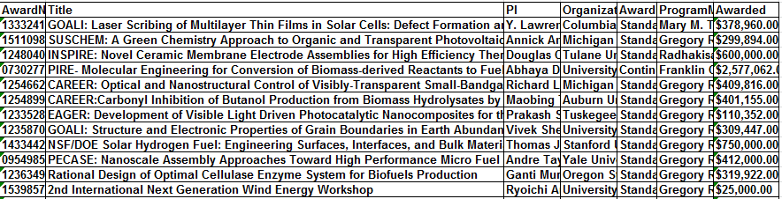
Award Search Results for
Energy for Sustainability Program
Partial results of award search with program element 7644
201 active awards on 7-29-15
http://www.nsf.gov/awardsearch/advancedSearch.jsp

Slide 56
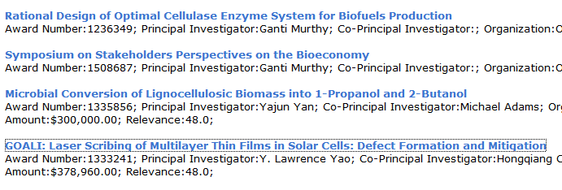
Award Search Results for Energy for Sustainability Program
Click on award title to get more information and abstract (next two slides)

Slide 57
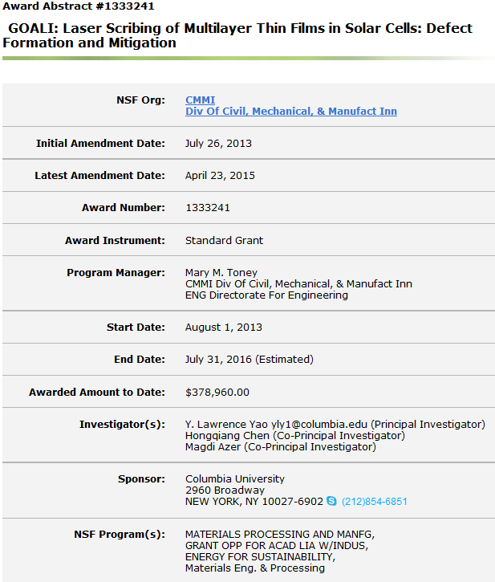
Example Award Information

Slide 58
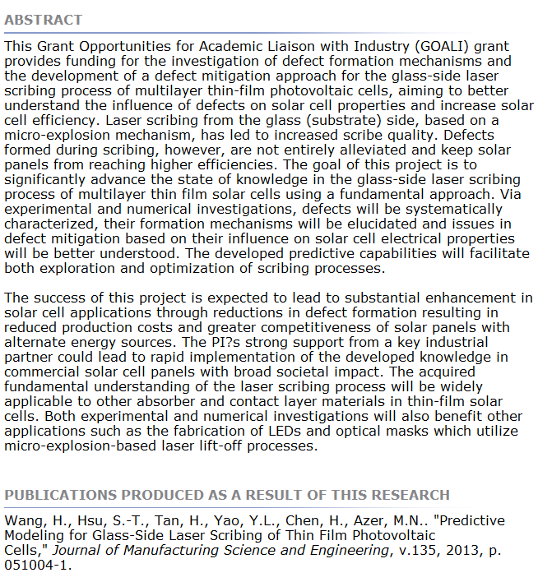
Example Award Abstract

Slide 59
Award Statistics
◆ Distribution by experience
⧫ Approximately 30% new investigators
⧫ 70% recently funded by NSF
◆ Success rates
⧫ Unsolicited proposals about 15%
⧫ CAREER about 15%
⧫ Initiatives about 10% (varies widely)
⧫ In CBET over 80% of awards from Highly Recommended category from panel review

Slide 60
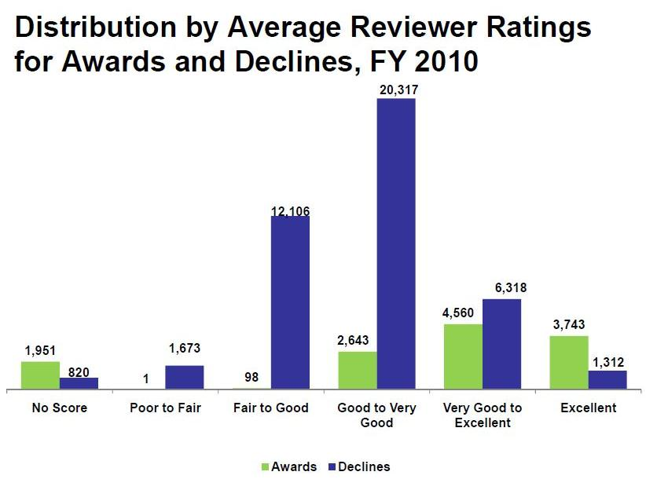
Distribution by Average Reviewer Ratings
For Awards and Declines, FY 2010
12,996 Awards
42,546 Declines
55,542 Proposals

Slide 61
If Proposal Not Funded
◆ Read reviews – consider resubmission
⧫ Minor problems noted: fix poor proposal organization, references insufficient
⧫ Reviewers did not seem to appreciate innovations: re-emphasize key elements
⧫ Mixed reviews: stress aspects of proposal relevant to negative comments
⧫ Consistently low ratings: usually an indication of weak or incremental research

Slide 62
If Proposal Not Funded
◆ Read reviews – consider other options
⧫ Consistently high ratings: Is little funding available? Is research area of low priority?
⧫ Is the work more appropriate for another agency or industry funding?
⧫ Contact program director for advice: Is resubmission recommended? Is research area a priority? What is the funding situation?

Slide 63
Resubmitting a Proposal
◆ Rewrite the proposal by incorporating changes based on reviewer comments; resubmitting three times is a practical limit
◆ For NSF addressing reviewer comments in a separate section is not recommended; other agencies require a separate section
◆ The title need not be changed if the scope does not change
◆ In most NSF directorates many new panelists will review your resubmission

Slide 64
Post Award Considerations
◆ Keep program director informed
⧫ Write nuggets (research achievements) when requested
⧫ Give advance notice of significant publications (e.g., Science, Nature); the NSF public relations department (OLPA) can help publicize
⧫ Submit annual report (90 days before anniversary of grant) and final report (90 days after grant expiration)
◆ Request supplements
⧫ Research Experiences for Undergraduates (REUs) and Research Experiences for Teachers (RETs) are common
⧫ International supplements available

Slide 66
https://www.nsf.gov/about/congress/reports/nsf_big_ideas.pdf

Slide 68
ENG Funding
(Dollars in Millions)
 | FY 2015 Actual | FY 2016 Estimate | FY 2017 Request | Change Over FY 2016 Estimate
 |  |  |  | Amount | Percent
Chemical, Bioengineering, Environmental, and Transport Systems (CBET) | $180.40 | $183.82 | $198.42 | $14.60 | 7.9%
Civil, Mechanical, and Manufacturing Innovation (CMMI) | 225.55 | 216.39 | 233.92 | 17.53 | 8.1%
Electrical, Communications, and Cyber Systems (ECCS) | 118.97 | 113.95 | 122.77 | 8.82 | 7.7%
Engineering Education and Centers (EEC) | 117.95 | 107.61 | 120.32 | 12.71 | 11.8%
Industrial Innovation and Partnerships (IIP) | 227.26 | 239.93 | 268.90 | 28.97 | 12.1%
Emerging Frontiers and Multidisciplinary Activities (EFMA) | 53.41 | 54.49 | 58.40 | 3.91 | 7.2%
Total, ENG | $923.53 | $916.19 | $1,002.73 | $86.54 | 9.4%

Slide 69
Funding for FY 2017 Cross-Foundation Investments
(Dollars in Millions)
 | FY 2015 Actual | FY 2016 Estimate | FY 2017 Request | FY 2017 Request Change Over FY 2016 Estimate
 |  |  |  | Amount | Percent
Understanding The Brain (UtB) | $109.39 | $146.93 | $141.62 | -$5.31 | -3.6%
Risk and Resilience | 19.34 | 41.15 | 43.15 | 2.00 | 4.9%
Innovations at the Nexus of Food, Energy, and Water Systems (INFEWS) Inclusion across the Nation of Communities of Learners of Underrepresented Discoverers in Engineering and Science (NSF INCLUDES) | - | 48.68 | 62.18 | 13.50 | 27.7%
 | - | 15.50 | 16.00 | 0.50 | 3.2%

Slide 70
FY 2017 Funding for Ongoing NSF-Wide Investments
(Dollars in Millions)
 | FY 2015 Actual | FY 2016 Estimate | FY 2017 Request | FY 2017 Request Change Over FY 2016 Estimate
 |  |  |  | Amount | Percent
Cyber-Enabled Materials, Manufacturing and Smart Systems (CEMMSS) | $269.83 | $256.30 | $257.12 | $0.82 | 0.3%
Cyberinfrastructure Framework for 21st Century Science, Engineering, and Education (CIF21) | 157.04 | 132.42 | 100.07 | -32.35 | -24.4%
NSF Innovation Corps (I-Corps™) | 26.19 | 30.00 | 30.00 | - | -
Research at the Interface of Biological, Mathematical, and Physical Sciences (BioMaPS) | 35.47 | 31.31 | 29.81 | -1.50 | -4.8%
Science, Engineering, and Education for Sustainability (SEES) | 183.01 | 74.73 | 52.48 | -22.25 | -29.8%
Secure and Trustworthy Cyberspace (SaTC) | 124.71 | 129.75 | 149.75 | 20.00 | 15.4%

Slide 71
Federal Academic R&D Support FY 12 - $40.1 Billion Total
DOD
$4.9
NSF
$5.3
SOURCE: National Science Foundation, National Center for Science and Engineering Statistics, Higher Education Research and Development Survey, FY 2012
Table 5-4, http://www.nsf.gov/statistics/seind14/index.cfm/appendix/tables.htm

Slide 72
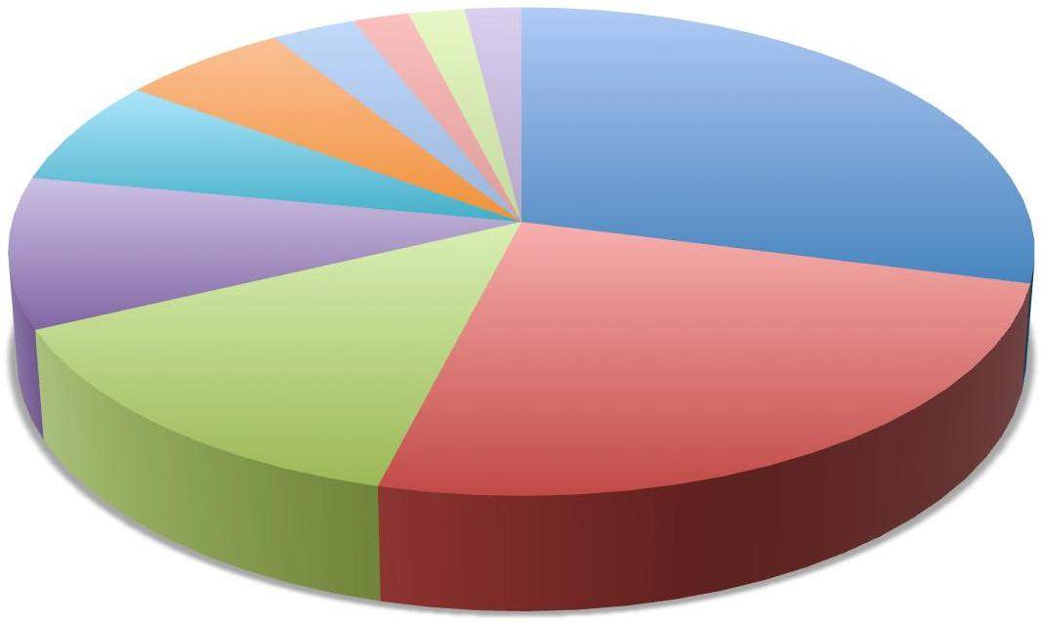
CBET Average Annual PI Budget
(~$100,000/yr)
Travel
3%
Postdoc
2%
Equipment
2%
Sub-awards
2%
Fringe
Benefits
6%
2%
2%
2%
Materials
7%
Indirect
29%
Sr Personnel
10%
Other
14%
Grad Students
25%

Slide 73
Final Thoughts
◆ Contact program directors
⧫ Meet at professional society conferences
⧫ Volunteer to review proposals. Send e-mail to program director
◆ Examine successful proposals
⧫ Ask colleagues for their proposals
⧫ Get proposal reviews from colleagues
◆ Suggest reviewers for your proposal
⧫ Use FastLane form provided

Slide 74
Faculty Early Career Development Program
(CAREER)
Faculty Early Career Development Program
CAREER
NSF 15-555; new solicitation expected spring 2017
Notes:
74

Slide 75
CAREER: Program Goals
◆ NSF's awards for new faculty members
◆ Awardees are selected on the basis of
their plans to develop highly integrative
and effective research and education
careers
◆ Increased participation of those
traditionally underrepresented in
science and engineering encouraged
Notes:
75

Slide 76
CAREER: Eligibility
Applicants Must:
◆ Hold a doctoral degree as of submission date
◆ Be untenured as of submission date
◆ Be employed in a tenure-track (or
equivalent) position as of October 1 following submission
◆ Be employed as an assistant professor
(or equivalent) as of October 1 following submission
◆ Have not competed more than two times
previously in the CAREER program
◆ Have not previously received an NSF
CAREER or PECASE award
Notes:
76

Slide 77
CAREER Revisions from
Previous Solicitation
Letters of Collaboration must now be in a standard one-sentence format: “If the proposal submitted by Dr. [insert the full name of the Principal Investigator] entitled [insert the proposal title] is selected for funding by the NSF, it is my intent to collaborate and/or commit resources as detailed in the Project Description.”
The need for the collaboration should be included in the project description
Notes:
77

Slide 78
CAREER Proposals
◆ Critical Elements
⧫ Research and education
⧫ Departure from Ph.D. work
◆ Special Considerations
⧫ Panel review - - bring reviewers up to speed
⧫ PI specifies program for initial assignment
◆ Logistics
⧫ Submit early and resubmit if necessary
⧫ Follow-up: check for successful submission
⧫ Fix errors through FastLane before deadline
⧫ About 1% of proposals returned unreviewed
Notes:
78

Slide 79
CAREER: Departmental Letter
◆ Departmental Letter
⧫ An indication that the PI’s CAREER activities are supported by and integrated into the goals of the department and organization, and the department is committed to the support, mentoring and professional development of the PI
⧫ A description of the relationship between the CAREER project, the PI’s career goals and job responsibilities, and the goals of his/her department/organization
⧫ Verify the PI eligibility.
Notes:
79

Slide 80
CAREER: Proposal Review
◆ Evaluated (mostly by panels) incorporating NSF’s two merit review criteria:
⧫ What is the intellectual merit of the
proposed activity?
⧫ What are the broader impacts of the
proposed activity?
◆ Reviewers are also asked to consider the
capability of the applicant to make an
integrative contribution to both education
and research and to integrate diversity in
all program activities.
Notes:
80

Slide 81
CAREER:
Award Duration and Size
◆ 5-year duration
◆ Minimum award size of $400,000
◆ BIO, ENG directorate and PLR division minimum award size of $500,000
◆ Although no maximum award size, justify requests above minimum. Contact program director for requests significantly above minimum.
Notes:
81

Slide 82
Education Component –
Critical to Success
Note any of your previous results with successful education activities
Leverage activities at your institution; multiple activities are common
Integrate education activities with research
Reference relevant education literature
Assess impact of activities; may need collaborators

Slide 83
CAREER Deadlines
July 21, 2016 ENG was the previous CAREER deadline.
Submission deadlines are generally during the third week in July. Check the new CAREER announcement, due out in the spring of 2017, for FY 17 deadlines.
Notes:
83

Slide 84
PECASE
◆ Presidential Early Career Awards for
Scientists and Engineers
◆ Recognizes outstanding scientists and
engineers who, early in their careers,
show exceptional potential for
leadership at the frontiers of knowledge
◆ Highest honor bestowed by the U.S.
government on scientists and engineers
at the beginning of their careers
Notes:
84

Slide 85
CAREER & PECASE
◆ NSF will nominate approximately twenty
PECASE awardees. Final selection
coordinated by OSTP.
◆ Number of slots per directorate will be
determined by number of proposals received
in each directorate
◆ Each directorate will nominate their
most meritorious CAREER PIs for PECASE.
No PI input is accepted
◆ PECASE awardees will generally be
announced in the fall following receipt of the
CAREER award
Notes:
85

Slide 86
PECASE: Eligibility
◆ NSF Applicants:
⧫ Must meet all of the CAREER eligibility requirements
⧫ Must be U.S. citizens, nationals, or permanent residents who hold such status on or before their Directorate's deadline (usually July) for submission of CAREER proposals
⧫ Can receive only one PECASE award
Notes:
86

Slide 88
ARRA

Slide 89
ARRA

Slide 90
CBET | 501
BIOMEDICAL ENGINEERING | 73
ENVIRONMENTAL ENGINEERING | 66
BIOTECH, BIOCHEM & BIOMASS ENG | 46
THERMAL TRANSPORT PROCESSES | 35
CATALYSIS AND BIOCATALYSIS | 34
FLUID DYNAMICS | 30
ENVIRONMENTAL SUSTAINABILITY | 30
PARTICULATE &MULTIPHASE PROCES | 29
PROCESS & REACTION ENGINEERING | 26
COMBUSTION, FIRE, & PLASMA SYS | 26
Gen & Age Rel Disabilities Eng | 20
BIOPHOTONICS, IMAGING &SENSING | 20
ENERGY FOR SUSTAINABILITY | 20
CHEMICAL & BIOLOGICAL SEPAR | 17
NANO-BIOSENSING | 16
Enviro Health & Safety of Nano | 13
CMMI | 426
Dynamics, Control and System D | 57
Materials Eng. & Processing | 56
Biomechanics & Mechanobiology | 45
Service, Manufacturing, and Op | 44
Mechanics of Materials and Str | 42
Structural and Architectural E | 35
CIVIL INFRASTRUCTURE SYSTEMS | 27
Engineering for Natural Hazard | 27
Manufacturing Machines & Equip | 27
ENGINEERING DESIGN AND INNOVAT | 20
Geotechnical Engineering and M | 14
NANOMANUFACTURING | 12
INFRAST MGMT & EXTREME EVENTS | 10
Systems Science (SYS) | 6
Design of Eng Materials (DEMS) | 4
EEC | 23
ENGINEERING EDUCATION | 14
ENG DIVERSITY ACTIVITIES | 9
ECCS | 166
ENERGY,POWER,ADAPTIVE SYS | 58
COMMS, CIRCUITS & SENS SYS | 54
ELECT, PHOTONICS, & MAG DEVICE | 50
CDS&E | 2
CYBER-PHYSICAL SYSTEMS (CPS) | 2
ENG received total of 1116 CAREER proposals (after compliance checking)

Slide 91
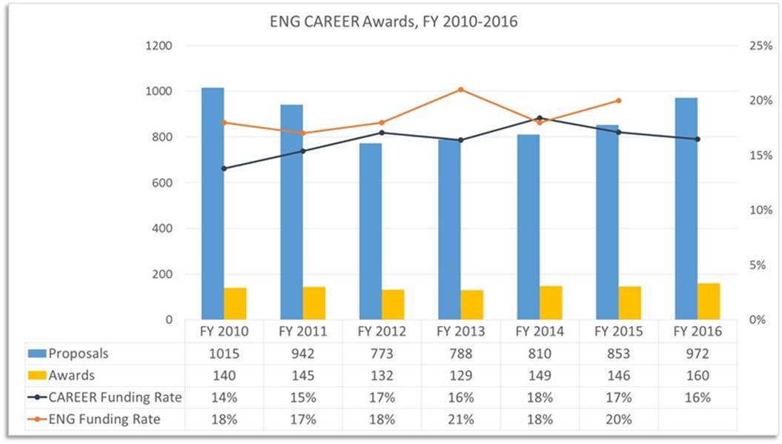

Slide 92
Number of Years as an Assistant Prof When CAREER Award Received
Most successful applicants receive a CAREER award two to four years after their initial appointment
Number of CBET CAREER Awards
Year CAREER Award Received

Slide 93
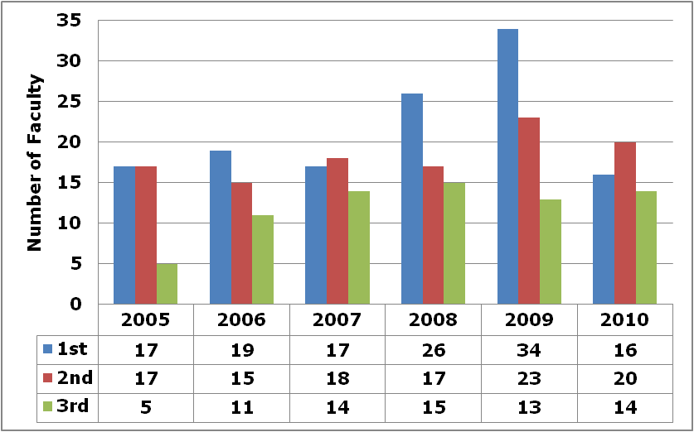
Number of Attempts for CBET CAREER Award
Most successful CBET CAREER awardees receive a grant on the first or second attempt

Slide 94
Did New Faculty Arrive Directly from Grad School?
Most new CBET CAREER awardees had previous experience (generally as postdocs) prior to an initial faculty appointment.

Slide 95
CAREER: Useful Websites
◆ CAREER Homepage:
http://www.nsf.gov/career
⧫ Program Solicitation
⧫ Submission Checklist
⧫ Awards lists and abstracts
FAQ:
http://www.nsf.gov/publications/pub_summ.jsp?ods_key=nsf15057&org=NSF
Notes:
95

Slide 96
Other New Faculty Proposal Opportunities
◆ Beckman Young Investigators Permanent
Resident Alien / Tenure-Track / U.S. Citizen Award
$264K over 3 years / Deadline December 1
http://www.beckman-foundation.org/
◆ Camille and Henry Dreyfus Foundation
New Faculty Award $50,000 before new
faculty members begins their first tenure-track
appointment, for U.S institutions with PhD granted
in chemistry, biochemistry, or chemical engineering
http://www.dreyfus.org/
◆ Microsoft Research New Faculty
Fellowship Program ‘advancing computing
research in novel directions’ / $200K / due
typically in October
http://research.microsoft.com/en-us/collaboration/awards/msrff.aspx
Notes:
96

Slide 97
Other New Faculty Proposal Opportunities - 2
◆ Office of Naval Research Young Investigator Program
Must have received Ph.D. within last 5 years. Maximum award size is $170,000/year for three years. Up to 15 awards
http://www.onr.navy.mil/Science-Technology/Directorates/office-research-discovery-invention/Sponsored-Research/YIP.aspx
Notes:
97

Slide 98
NSF Engineering Directorate Activities
Notes:
98
Last July we concluded that we need to “rethink the ENG Directorate.” The the creation of the “Strategic Thinking Group,” which became the strategic planning group, with Kesh Narayanan as Chair.
A great deal has happened since last July when we began strategic planning
Some of the flavor came out at AdCom last fall.
Several things are now going on:
Joe Bordogna says he would like to see ENG “lifted up”
Arden Bement says that we should be looking for the big thing were we can have an impact
But, though we were on the upswing on the budget, ‘o5 was the first time we have not had ~ 10% increase in 6 years.
We are told that budgets overall may be flat over the next few years.
The success rates of awards (I.e. awards/submissions) have been declining and are quite low.
Seems to be a lot of agreement that curriculum changes need to be made (professional societies & ABET, CE, EE, ME. Methods of teaching need to be improved.
NAE study on Assessing the Capacity of the U.S. Engineering Research Enterprise.
NAE Study on the future of engineering education (2020 report)
National Innovation Initiative from the Council on Competitiveness
We have an outstanding group of DDs and PDs in place to make up the leadership team.
Conclusion: We need to change – and not the “tweaking kind of changes.” We need to be transformational. And that concept is going to be very evident during my presentation.

Slide 99
Directorate for Engineering
Emerging Frontiers and
Multidisciplinary Activities
(EFMA)
Office of the Assistant Director
Deputy Assistant Director
(OAD)
Senior Advisor
Nanotechnology
Engineering
Education and
Centers
(EEC)
Civil,
Mechanical, and
Manufacturing
Innovation
(CMMI)
Chemical,
Bioengineering,
Environmental,
And Transport
Systems
(CBET)
Electrical,
Communications
and Cyber
Systems
(ECCS)
Industrial
Innovation and
Partnerships
(IIP)

Slide 100
Special On-going NSF Programs that Involve ENG PIs
GOALI: Grant Opportunities for Academic Liaison with Industry - Collaboration with industrial co-PI
ERC: Engineering Research Centers – Multi-disciplinary groups working on engineering topics
STC: Science and Technology Centers - Multi-disciplinary groups working on S&T
MRI: Major Research Instrumentation – Acquisition of large (usually shared) instruments
PIRE: Partnerships for International Research and Education - Support for US faculty and students to work on multidisciplinary topics with international partners
Notes:
Deadline around January/February each year.
http://www.nsf.gov/funding/pgm_summ.jsp?pims_id=503160&org=ENG&from=home

Slide 101
Special NSF Initiatives that Involve ENG PIs
NSF/DOE Partnership in Basic Plasma Science and Engineering – Research on the fundamentals of large ensembles of free charged particles (16-564)
Innovations at the Nexus of Food, Energy, and Water (INFEWS) – Synthesis and analysis of FEW using a systems approach (16-524)
Professional Formation of Engineers – Research in the construction of engineering knowledge, engineering identity, and the engineering profession (15-539)
Cyberlearning and Future Learning Technologies – integrate emerging technologies with advances in what is known about how people learn (14-526)
Innovation Corps Teams Program Interdisciplinary Ventures – NSF-funded researchers receive additional support to accelerate innovation that can attract subsequent third-party funding (12-602)
Other Relevant Initiatives:
http://www.nsf.gov/dir/index.jsp?org=ENG
http://www.nsf.gov/funding/pgm_list.jsp?org=NSF&ord=rcnt
Notes:
Deadline around January/February each year.
http://www.nsf.gov/funding/pgm_summ.jsp?pims_id=503160&org=ENG&from=home

Slide 102
Special Programs for High-risk and Quick-response Research
EAGER - High-risk, exploratory and potentially transformative research requests up to $300K and two-year duration
RAPID - Quick-response research on natural or anthropogenic disasters and similar unanticipated events. Requests may be for up to $200K and one year duration
Submit anytime, but must talk to Program Director first

Slide 103
Emerging Frontiers and Multidisciplinary Activities (EFMA)
EFMA focuses support on important emerging areas in a timely manner
Typically, the annual budget for EFMA will be 3-to-5% (~$15-to-$30 million)of the Directorate budget
Current Emerging Frontiers in Research and Innovation (EFRI) topics (16-502)
Advancing Communication Quantum Information Research in Engineering (ACQUIRE)
New Light and Acoustic Wave Propagation: Breaking reciprocity and time-reversal symmetry (NewLAW)

Slide 104
CBET Award Size and Duration Have Remained Stable
Notes:
Budget went up by ~15mil in 2012, resulted in more awards and larger sizes

Slide 105
Most CBET Awards to ChEs, MEs & BMEs
All Competitive Proposals Submitted FYs 2009 & 2010

Slide 106
Education and Human Resources
Division of Undergraduate Education
S-STEM: Need-based scholarships for students to enter STEM fields
IUSE: Improving Undergraduate STEM Education; improving STEM programs and learning outcomes
Division of Graduate Education
GRFP: Graduate Research Fellowship Program
NRT: NSF Research Traineeships; student track and curriculum research track

Slide 107
Office of International Science and Education (OISE) Activities at NSF
OISE supports international activities Foundation wide:
Co-fund new proposals submitted to NSF
disciplinary programs
Co-fund supplements to existing NSF grants
New proposals to OISE, e.g., PIRE
Key elements for OISE co-funding:
Intellectual collaboration
Leverage expertise and resources
US junior researchers and students

Slide 108
Key OISE Programs
PIRE - Partnerships for International Research and Education: flagship program for US groups collaborating with international teams
Planning Visits and Workshops – small grants to help initiate international work
PASI - Pan-American Advanced Studies Institutes: short courses for advanced graduate students and postdocs
International Research Fellowships – overseas research opportunities for young scientists
IRES – International Research Experiences for Students: small groups of students work on focused research projects overseas
EAPSI – East Asia Pacific Summer Institutes: two month Asian research experiences

Slide 109
Time Management
Notes:
Page 97No matter how early you wake up, it might seem like there are never enough hours in the day to squeeze it all in. It, of course, being your job, your meals, your relationships, your sleep, and your Netflix queue.
Trust me, I know how you feel. For the past year and a half, I’ve been making around $5,000 per month from freelance writing—making me a “full-time writer” by most standards. But unlike the majority of full-time writers, I’m also a college student. That means on top of my work, I’m also balancing approximately 20 hours of class per week and 15 hours of homework and studying.
Even if you graduated many (many) years ago and even if starting a side gig is the last thing on your mind, we both have the same time management struggles in common. I don’t know a single person who can master it day in and day out.
However, balancing a thriving freelancing business with a full course load has led me to try some pretty creative time-management solutions. And all the trial and error has resulted in a few strategies that really do work.
Here are my top four techniques for beating procrastination, staying focused, and maximizing your day—no matter what you do.
Read more: Your 4-Step Guide to Solving Any Problem at Work—Faster
1. Pick a System—and Stick to It When I first started freelancing, I didn’t have a productivity system. I relied on a notepad to keep track of current tasks, and as I worked, I’d simply move down the list and check things off.
But of course, this set-up meant I was often tackling low-priority projects before more important or urgent ones. So I moved to my list to Todoist. This free app lets you assign deadlines and priority statuses to your to-dos, making it obvious what you should be working on at any given time.
Since making the leap, I’ve managed to turn in hundreds of articles and essays to clients and professors, respectively, without ever missing a deadline.
You definitely don’t need to use Todoist (or any app, for that matter) to be productive. However, having some sort of system is essential. It could be GTD, energy mapping (Muse CEO Kathryn Minshew’s system!), or the 1-3-5 rule—just don’t wing it, or you’ll (literally) waste your time.
2. Figure Out How You Use Your Time Most people consider themselves fairly productive. I sure did—until I started tracking my time. I discovered I was spending hours a day reading blog posts, scrolling through LinkedIn and Twitter, and looking at designs on Behance and Dribble. Since I wasn’t on Facebook or Instagram, I didn’t feel like I was wasting time, but there’s no doubt I could’ve been putting those hours to better use.
That’s why I wholeheartedly recommend using a time-tracking tool. My favorite isRescueTime: The free version tells you exactly how much time you’re spending on individual websites and apps and grades your activity from “very productive” to “very distracting.” You can also set goals, such as, “80% of the time I spend online will be productive.”
I’ve upgraded to premium, and it’s been a fantastic decision. For $72 a year, this version lets you block distracting websites, track time spent in meetings and calls, keep a log of your daily accomplishments, and more.
Toggl is a solid alternative to Rescue Time. Unlike RescueTime, which is always running, Toggl only tracks your time when you click the in-app timer. You can categorize your time by project (for example, “research for Smithsonian Magazine piece”), by tag, or both.
Plus, Toggl comes with a Pomodoro Timer, which is handy if you like working in sprints with periodic breathers.
Read more: 14 Free Personality Tests That’ll Help You Figure Yourself Out
3. Stop Going Down Internet Rabbit Holes As time-tracking showed me, and as you probably already know, it’s incredibly easy to get off-track while doing anything online. Whenever I came across something that piques my curiosity—whether it was an interesting article, a cool site, or a piece of breaking news—I felt compelled to pause what I was doing and check it out, just for a minute, or five, or 30.
The problem? Not only was I delaying my original task, but research shows jumping between unrelated activities temporarily lowers your IQ and boosts your stress level. Not good.
So, I decided to establish a new routine. I downloaded Pocket, an app that lets you save articles, webpages, and videos to read later. (Feedly and Evernote’s web extension are also great options.) Every time I find an intriguing link, I save it to Pocket and move on with my work.
At the end of the day, when my energy reserves are basically tapped out and I just want to relax, I’ll open up Pocket and browse everything I bookmarked. And if saving links doesn’t help you stop going down that hole, think about browser extensions like StayFocusd for Chrome that allow you to block specific sites (cough Facebook cough). Oh, and if your phone serves as a similar distraction, consider taking the steps productivity writer Tristan Harris advises to become less addicted.
Read more: 6 Times You Can Use a Free Salary Calculator to Get Ahead in Your Career
4. Keep a Running List of Small Tasks For every hour I spend writing, I spend two hours doing small, fairly administrative tasks: sending invoices, answering emails, checking in with clients, and so on.
Whether you’re in a creative role or a more technical one, you’ve probably got a similar ratio of big projects to small, boring-but-necessary ones. I’ve discovered it’s more efficient to create a bank of these mini assignments and do them whenever I have a short break, rather than periodically clearing my to-do list of the small stuff.
That’s because the day is chock-full of awkward pockets of time. How many times have you had an hour-long call that wraps up seven minutes early? Sure, you could hop on to Slack and send a funny GIF to your co-workers, or you could knock out a small task. Or maybe you’re meeting someone for coffee, and you get there four minutes early. Rather than scrolling through Twitter, quickly consult your list, find a mini-project, and complete it just as your friend walks through the door.
These days, it’s nearly impossible to find a professional who doesn’t feel busy. But just because you’ve got a mile-long to-do list doesn’t mean you need to feel overwhelmed. With these strategies up your sleeve, you can accomplish what you need to—and still have time for your side gig (or some Netflix).
This post has been excerpted and lightly edited from Aja Frost’s ebook, How to Start a Freelance Writing Career From Scratch.
This post is in partnership with The Muse. The article above was originally published on The Muse.

Slide 110
Academic Freedom Lots of it and no personal assistant!
Academic tasks
teaching
research
book writing
Non-academic tasks
calendar
filing
student recruiting
Mandated time
classroom
grading
report writing
committee meeting
Discretionary time
literature reading
proposal writing
email
session chair
Notes:
Page 98

Slide 111
Time Management Exercises
◆ Write down the most important
time saver that you use
◆ Write down the largest time
waster you face
◆ Share tips
Notes:
Page 98

Slide 112
Know Yourself
◆ Perform time audit
⧫ For 1 week log what you do every 30 min; RescueTime app for internet time
◆ When do you work best?
⧫ Internal – time alone
⧫ External – time in groups
◆ Cannot do everything – know
priorities
◆ Decide flexibility level you can
tolerate
Notes:
Page 99

Slide 113
Task Classification Agenda vs. Calendar
Urgency
III
I
IV
II
Importance

Slide 114
Classifications
Urgent and important. (Deadline-driven activities that further your goals.)
Important but not urgent. (Long-term professional, family, and personal activities that further your goals.)
Urgent but not important. (Much e-mail, many phone calls and memos, things that are important to someone else but don’t further your goals.)
Neither urgent nor important. (TV, computer games, junk mail.)
S.P Covey, A.R. Merrill, and R.R. Merrill, First Things First, New York, Simon & Schuster, 1994.

Slide 115
Recommendations
◆ Commit to several hours a week on
Quadrant II items, and cut down on
time spent in Quadrants III and IV.
◆ Work on Quadrant I and II items
when you’re at peak efficiency.
◆ If you’re trying to write a book, put it
on the Quadrant II list, otherwise it
will never get written.

Slide 116
Tips
◆ 55 hours/week doing professor stuff
is about right
⧫ More productive, creative, accurate
◆ Touch stuff only once, if possible
◆ Ask for help when needed
◆ Delegate with clear instructions of
expectations
◆ Maintain a list of ‘mindless tasks’ and do those when you need or have a break
Notes:
Page 101

Slide 117
More Tips
◆ Schedule meetings at office of others –
you can leave
◆ Know your business and say no to others
⧫ Learn to say no nicely
⧫ “I’m sorry, but I’ve just got too many other
commitments right now.”
⧫ “Good talking to you, but I’ve got something
I need to attend to now.”
◆ Learn to finish
⧫ Don’t keep revising (perfectionist) needlessly
⧫ One writing/proofing on low importance
items
◆ Browsing internet/FB/Tweet following … are leisure time activities

Slide 118
Keeping track of it all
◆ Keep track of tasks
❖ Develop own system; use an app (e.g. Todoist)
❖ Schedule all priority activities: research, writing,
student advising/direction, professional development
❖ Schedule teaching preparation time (not too early
or late – will make a better teacher)
◆ Schedule large blocks of time
❖ Understand work ‘start-up’ time, location
◆ Schedule personal time
❖ Vacations, growth, extra fun day on travel
◆ Stick to it (as much as possible)
❖ Others will adapt
Notes:
Page 99

Slide 119
Keeping track of it all
◆ Use a to do list
❖ App, Outlook, paper
❖ Set aside time for daily update
◆ Filing system vs. Piling system
❖ Decide appropriate level of effort
❖ Larger chunks, delegate, electronic
❖ Decide Search engines work well
◆ Develop system for time sensitive stuff
Notes:
Page 100

Slide 120
(Optimal) Procrastination
◆ Fun vs. urgent vs. important
activities
◆ Fear factor is often cause
❖ Break into smaller tasks
❖ Schedule it
❖ Delegate it
❖ Reward or punish self
Notes:
Page 100

Slide 121
E-mail – The Great Interrupter
Establish time you respond to email
2- 5 times a day (people adjust)
Turn off bell/balloon – 4 min. transient
Read and respond – touch only once
Temporarily lowers IQ/raises stress
Assume that your e-mail messages
are not private.
◆ Never write a “hot” e-mail message.
It is too easy to send by accident. Don’t
ever send messages when you are angry.
◆ Make e-mail brief and proof-read it.
Notes:
Page 101

Slide 122
E-mail
◆ Don’t check e-mail 1st thing in the morning (do something important 1^{st,} e-mail is an excuse).
◆ Don’t check e-mail in late evening (interferes with sleep).
Minimize exchanges: ‘propose not ask’ Suggest solutions, use ‘if then’
Unsubscribe or block if you don’t read
Fewer and more concise message
If message train longer than 3, phone
Notes:
Page 101

Slide 123
E-mail
◆ If you will be away, have the e-mail
automatically reply that you will
respond when you return.
◆ Aliases are convenient for sending
e-mail to a number of people, but
the message loses its personal touch.
◆ Requests for people to do work are
much more effective if they are
addressed to only one person instead
of to a group.
Notes:
Page 101

Slide 124
E-mail
◆ Don’t read other people’s e-mail.
◆ For large back-log
Sort into respond, reference, delete; then process
Consider using temporary folder
www.inboxdetox.com
Notes:
Page 101

Slide 125
Telephone
◆ If the phone rings at a truly bad
time, such as the moment you’re
leaving for class, do not answer it.
◆ If a call is going to take more time
than you have available, it is polite
to ask if you can call back.
Notes:
Page 102

Slide 126
Telephone
◆ With sales people you do not want
to talk to, be polite but firm –
”I’m really not interested.” If the
caller is rude and ignores this,
repeat the statement and hang up.
◆ If you leave an important message
on an answering machine, make
sure you provide a way (e-mail or
return call) for the recipient to let
you know the message was received
and understood.
Notes:
Page 103

Slide 127
Postal Mail
◆ The goal is to handle each item
only once.
◆ Don’t handle mail (or e-mail) during
your prime work-alone times.
◆ Sort the mail into valid, invalid, and
semi-valid. Discard invalid mail or
save it for a very low energy period.
◆ Open the semi valid mail, scan it,
and reclassify it.
Notes:
Page 103

Slide 128
Postal Mail
◆ Open the valid mail, and as much
as possible complete whatever you
have to do – respond, file it, talk to
someone about it, or discard it at
one sitting.
◆ Do something to move mail forward
every time you pick it up.
◆ Write directly on the letter to
respond to the sender or to make
notes for yourself.
Notes:
Page 103

Slide 129
Postal Mail
◆ Respond immediately to the rare
truly urgent item by fax, e-mail,
or phone.
◆ When you send mail, include your
e-mail address, phone, and fax
numbers, and perhaps the URL to
your homepage on the letterhead.
◆ Envelopes should have return
addresses.
Notes:
Page 103

Slide 130
Postal Mail
◆ Letters should be polite, short,
and to the point.
◆ If you are really angry about
something, write a letter to calm
down, but do not send it. After
you have calmed down, put this
“hot” letter in the trash.
Notes:
Page 103

Slide 131
Time Management
#1. Set goals & prioritize.
#2. Delegate. How can we do this?
❖ To secretaries & assistants
❖ To graduate students and
undergraduates as part of learning
experience. (They don’t work for you!)
❖ Give clear assignments & responsibility
for details.
❖ Check on results & give feedback.
❖ Give credit.
#3. Use efficient processes.
Notes:
Page 105

Slide 132
To Achieve Flow, You Need:
1. Sense of control.
2. To set realistic goals & sub goals
3. Meaningful rules (e.g., sports & games)
4. Feedback on progress
5. Focused attention
6. Balance between challenge & skills
7. To increase challenge & skills
to prevent boredom
Notes:
Page 106

Slide 133
Truths
◆ There are 24 hours in a day –
everyone is given the same each day
◆ Rate at which humans communicate
is relatively constant
◆ If you are doing something you
really enjoy, it is not called work
◆ A proposal will not be funded
if not submitted
Notes:
Page 106

Slide 134
Closing Remarks
Notes:
Page 116

Slide 135
Establish Credibility
Amongst peers, research community, funding agencies
Methods include
Write review articles, attend meetings, visits to funding agencies
Presentations, workshop mode conferences
Review panels, volunteer in societies, white papers
Seminar chair, request papers, preliminary results
New faculty often given special consideration
Notes:
Page 110

Slide 136
CAREER DEVELOPMENT WORKSHEET 4
COMMON OBJECTIVES FOR NEW FACULTY
1. Build Network in Community
List 5 Research Peers: 1____________________ 2_______________________
3_____________________ 4___________________ 5________________________
List most important conference/workshop you should attend:
research: _______________________________________
professional:_______________________________________
education: _______________________________________
List eight senior professionals who will be asked to write recommendation/evaluation letters:
1_____________________________ 2______________________________
3____________________________ 4______________________________
5____________________________ 6______________________________
7____________________________ 8______________________________
What is the leading laboratory/group in your field?
_______________________________________________________
Notes:
Page 111

Slide 137
CAREER DEVELOPMENT WORKSHEET 4
2. Establish Credibility
List the two best journals in your field:
1._________________________ 2._________________________
Title of review article to be written in next five years:
_______________________________________________________
What is the most original idea you are now working on?
What award should you be nominated for in the next five years?
Notes:
Page 111

Slide 138
Attitude
Don’t take search process too seriously.
⧫ You will find your next position
Lighten up
⧫ Humor & laughter
⧫ Bad things happen to all professors – don’t dwell
on them or let them get you down.
⧫ Take the university as it is – reform it later.
Take care of yourself
⧫ Eat right, exercise, sleep enough
⧫ Spend time with “family”
◆ If you know something is right thing to do, do it!
Notes:
Page 112

Slide 139
And You Get Paid to Do It!
❖ Work with young, bright and eager
students
❖ Perform research on topics of my choice
(to a degree)
❖ Sabbatical every 7th year
❖ Travel
❖ Enjoy colleagues in own and other
disciplines, around the world
❖ Retire gracefully
❖ And have great job security (tenure)

Slide 140
Good Luck with the Job Search!
You will find your next position
And finish your papers!

Slide 141

Effective Teaching for New or Prospective Faculty Sunday, 3:30 P.M. - 6:00 P.M. Hilton Union Square 1 & 2 This is a workshop that focuses on how to prepare for your first class, including pre-course preparation and what to do prior to, during and after class. Simple, popular and effective teaching techniques are presented. We also cover items such as: managing a disruptive student in class, strategies to counteract cheating and what is FERPA. If you are attending this current session or the Meet the Faculty Candidate Poster session, you should strongly consider attending this workshop as well. Donald Visco (Akron) Lisa Bullard (NC State)

Slide 142
NSF Activities at the AIChE Meeting
Career Planning for Prospective Faculty: Tim Anderson (UMass) and Geoff Prentice (NSF), Sunday 10:00, Continental 3
INFEWS: JoAnn Lighty, DD CBET, Monday 3:15, Union Square 15 & 16
NSF CBET Programs: JoAnn Lighty, Carole Read, Rajakkannu Mutharasan, Bruce Hamilton, William Olbricht, Wednesday 8:30 – 11, Continental 3
Proposal Writing Tutorial: Dimitrios Papavassiliou, Wednesday 12:30, Continental 3
Interactive Breakout Panels: JoAnn Lighty, Wednesday 1:30, Continental 3
Grants and Proposals – How to fund Your Research, Bill Olbricht and Lakis Mountziaris, Wednesday 4:45, Union Square 22
NSF Suite
NSF Suite: Vista 45th Floor Hilton; Monday 9:30 – 5, Tuesday – Wednesday 8 – 5
Meetings with PDs: Tuesday 9 – 12 (sign up on Monday)
Speed Coaching: Tuesday 1 – 4 (sign up on Monday)

Slide 143
Bibliography
Slide 1 of 3
How to create a WINNING PROPOSAL, Jill Ammon-Wexler and Catherine Carmel, Mercury Communications Corporation, 1978
How to Write a Successful Research Grant Application, Edited by Willo Pequegnat and Ellen Stover, Plenum Press, 1995
The Winning Proposal, Herman Holtz, Terry Schmidt, McGraw-Hill Book Company, 1981
Proposal Preparation, Rodney D. Stewart, Ann L. Stewart, John Wiley & Sons, 1984
Writing Grants Step by Step, Mim Carlson, Jossey-Bass Inc., 1995
Notes:
Page 82

Slide 144
Bibliography
Slide 2 of 3
Handbook for Writing Proposals, Robert J. Hamper, L. Sue Baugh, NTC Business Books, 1995
Engineer's and Manager's Guide to Winning Proposals, Donald V. Helgeson, Artech House, 1994
The Complete Book of Model Fund-Raising Letters, Roland Kuniholm, Prentice Hall, 1995
Writing Successful Science Proposals, Andrew J. Friedland and Carol L. Folt, Yale University Press, New Haven & London, 2000
Notes:
Page 82

Slide 145
Bibliography
Slide 3 of 3
The "How To" Grants Manual, Successful Grantseeking Techniques for Obtaining Public and Private Grants, Third Edition, David G. Bauer, American Council on Education, Oryz Press, 1995
Applying for Research Funding, Joanne B. Ries and Carl G. Leukefeld, SAGE Publications, 1995
How to Write Proposals That Produce, Joel P. Bowman and Bernadine P. Branchaw, Oryz Press, 1992
Teaching Engineering, Phil Wankat,
https://engineering.purdue.edu/che/news_and_events/publications/teaching_engineering/index.html
The Academic Scientists’ Toolkit
http://nextwave.sciencemag.org/feature/cdctoolkit.shtml
Notes:
Page 83

Slide 146
Bibliography
How to create a WINNING PROPOSAL, Jill Ammon-Wexler and Catherine Carmel, Mercury Communications Corporation, 1978
How to Write a Successful Research Grant Application, Edited by Willo Pequegnat and Ellen Stover, Plenum Press, 1995
The Winning Proposal, Herman Holtz, Terry Schmidt, McGraw-Hill Book Company, 1981
Proposal Preparation, Rodney D. Stewart, Ann L. Stewart, John Wiley & Sons, 1984
Writing Grants Step by Step, Mim Carlson, Jossey-Bass Inc., 1995
Notes:
Page 82

Slide 147
Bibliography
Handbook for Writing Proposals, Robert J. Hamper, L. Sue Baugh, NTC Business Books, 1995
Engineer's and Manager's Guide to Winning Proposals, Donald V. Helgeson, Artech House, 1994
The Complete Book of Model Fund-Raising Letters, Roland Kuniholm, Prentice Hall, 1995
Writing Successful Science Proposals, Andrew J. Friedland and Carol L. Folt, Yale University Press, New Haven & London, 2000
Notes:
Page 82

